Slide 1

Unit 1: Lesson 4 Sounds like a plan

Slide 2
Read the Fun fact.
Task 1: Answer the questions..
1 Spring Fling festival takes place at North Melbourne on 3rd Saturday in October.
2 It offers a variety of live music and dance performances.
3 Yes, at Mamma Mia (Italian) and Wrap ’n’ Roll (Vietnamese) food truck.
4 V-ice food truck offers vegan desserts.
5 Yes, they can.

Slide 3
Read the dialogue between Olivia and Charlie A and notice the structure in bold.
Present contiuous
Present continuous je sadašnje glagolsko vrijeme koje upotrebljavamo kada opisujemo radnju koja se događa sada (now, at the moment) ili kada govorimo o planovima u nedalekoj budućnosti.
Tvorba: am/is/are + glagol(ING)
I am shopping.
You/We/They are fishing.
He/she/it is visting London.

Slide 4
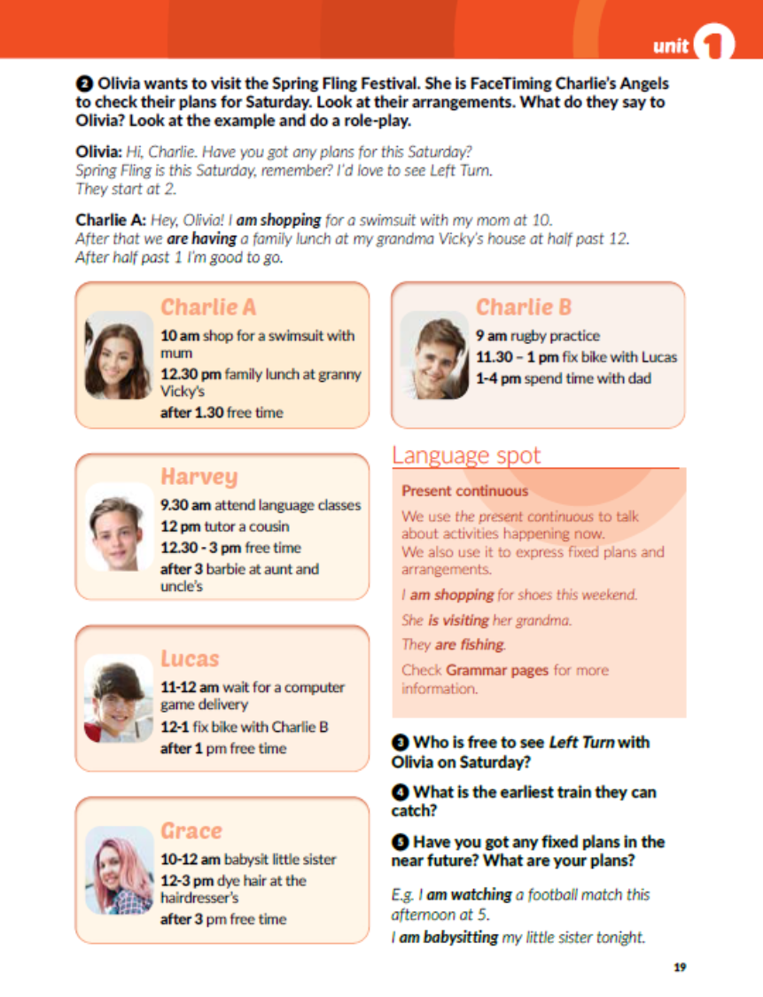
Task 2: Write a dialogue between Olivia and any of her friends. Don’t forget to use the present continuous.
E.g.:
Olivia: Hi, Harvey. Have you got any plans for this Saturday?
Harvey: Hey, Olivia. I am attending language classes at 9.30. After that I am tutoring my cousin at 12. I am free form 12.30 until 3 when I am having a barbie at my aunt and uncle’s.

Slide 5
Answer the questions in Task 3 and Task 4.
Task 5: What are your plans for the near future?
3 Charlie A, Harvey and Lucas are free to see Left Turn with Olivia.
4 They can leave at 1.30 after Charlie A finishes her family lunch at granny Vicky’s.

Slide 6
Open your workbook, page 13
Task 1: Match.
Task 2: Give a catchy name to a food truck..
E.g.:
Mexican food – burritos, nachos and enchiladas – El Diablo
Task 3: Write what Nora is doing today.
5
3
4
1
2
is picking up the dry-cleaning
she is doing the grocery shopping.
At 10 am she is going to the dentist.
At 11 am she is making a birthday cake for Sarah.
At 1 pm she is taking grandpa to the airport.
At 3 pm she is feeding Ethan’s cat.
At 4.30 pm she is delivering the cake.
At 5 pm she is waiting for the dishwasher repairman.
AT 7 pm she is taking out the garbage can.

Slide 7
Task 4: What are your arrangements next week? Complete the sentences. Use the present continuous.
Task 5: What are they doing at the moment? Use the present continuous.
she is trying on/wearing/buying a stripy T-shirt.
they are typing in silence.
she is having some tea.
he is tuning his guitar.
she is eating out.

Slide 8
Task 6: Circle the correct answer. Present simple – svakodnevne aktivnosti i dnevne rutine
Present continuous – radnja koja se događa sada ili planovi u neposrednoj budućnosti

Slide 9
Task 7: Complete the dialogue with the correct form of the verbs in brackets..
am meeting
are
wearing
is raining
is clearing
don’t like
do
do
listen
grab
don’t go
buy

Slide 10

Otvori sljedeću poveznicu, te odaberi LEARN MORE!
https://www.e-sfera.hr/dodatni-digitalni-sadrzaji/ac46d4e9-b211-4ebc-ac60-0e398b895e0f/

